Slide 1

Predicting Loan Defaults: Integrating Demographic and Financial Data in Machine Learning Models
Mulweli Mudau
January 2025

Slide 2
Introduction
Objective: The study involves building a machine learning model to predict loan default status from demographic and financial data.
Outline:
Data Summary and Description
Data Processing
Data Visualisation
Building Machine Learning Models
Performance Metrics
Results
Discussion and Conclusion

Slide 3
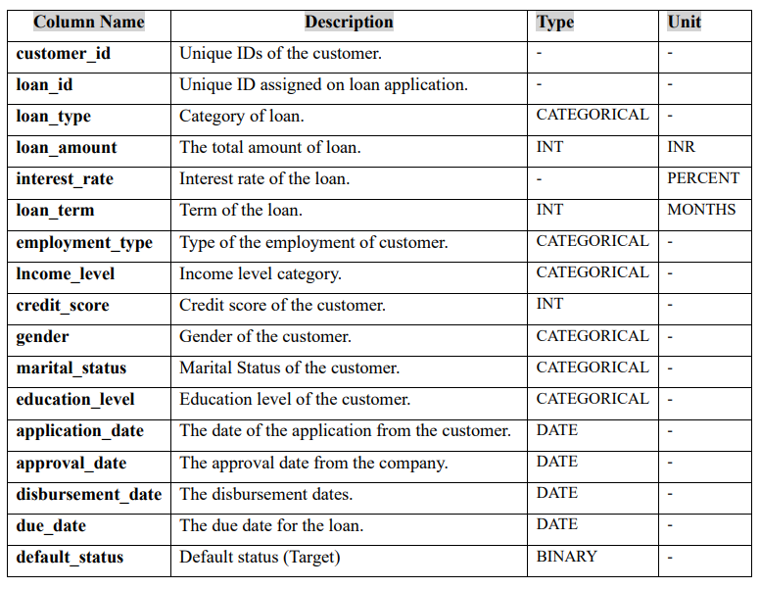
Data Description
Dataset Summary:
Key points: 17 columns, 5000 non-null entries, 5 in numeric and others are objects.

Slide 4
Data Preprocessing
Outline of the preprocessing steps taken:
Handling missing values
Dropping unnecessary columns
Converting categorical data

Slide 5
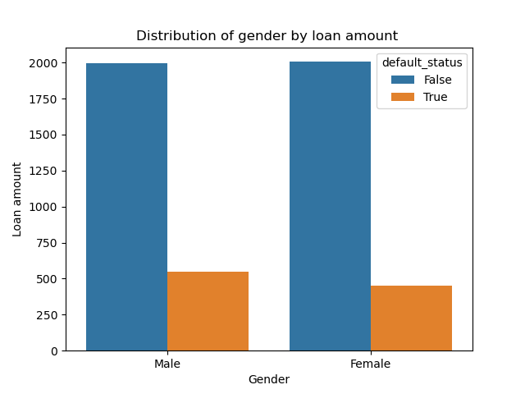
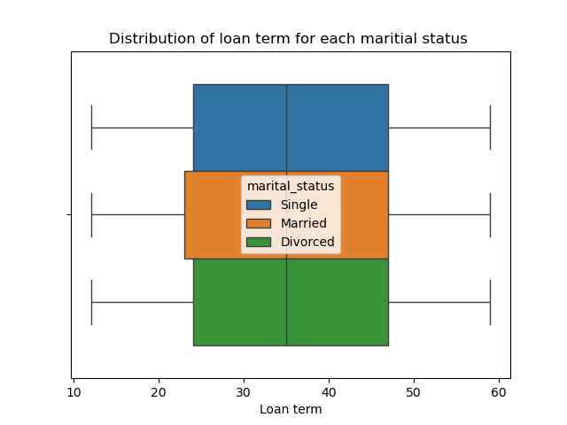
Data Visualisation

Slide 6
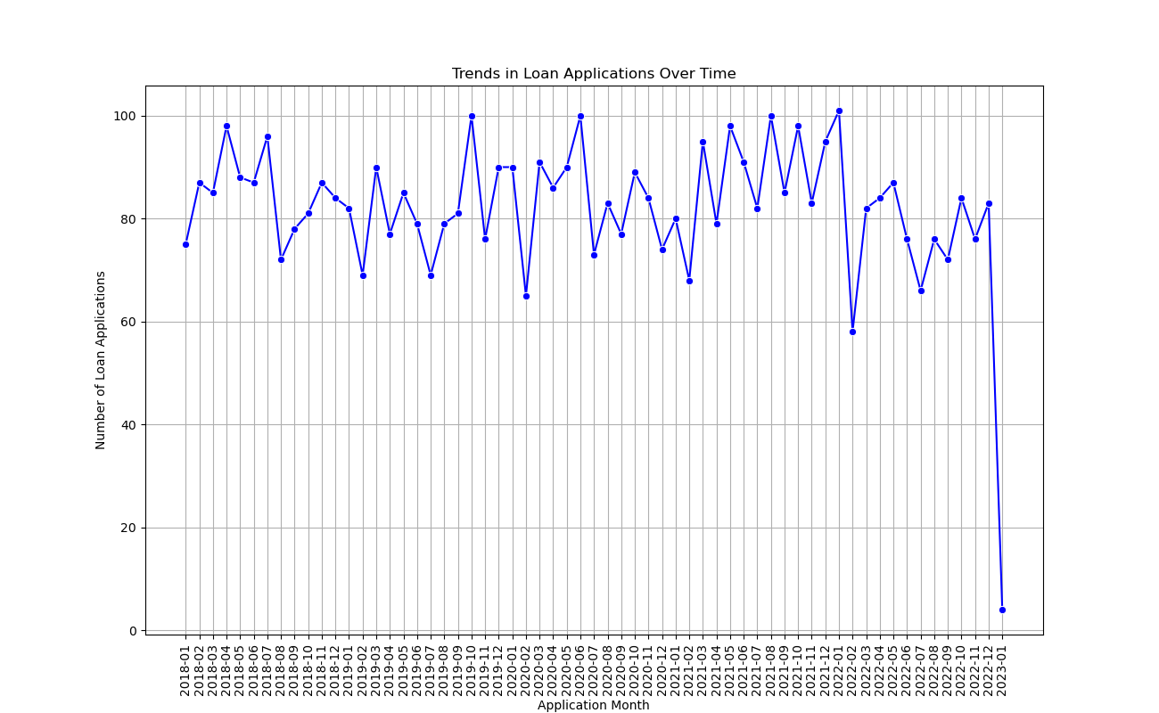
Data Visualisation Continued

Slide 7
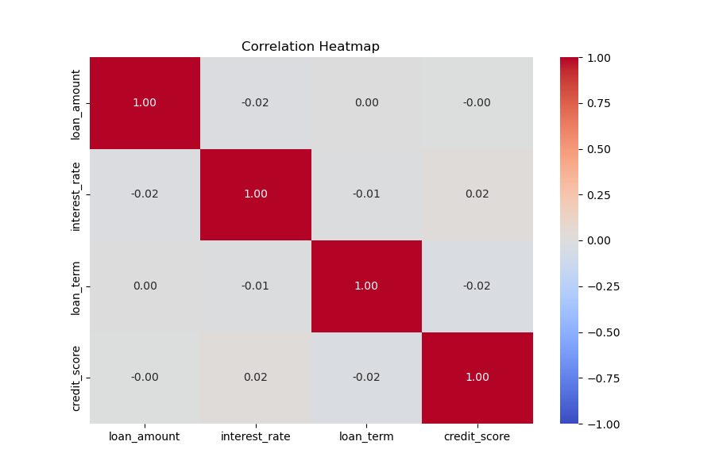
Data Visualisation Continued
Heatmap of correlation of numeric data

Slide 8
Building Machine learning Models
Models selected:
K-Nearest Neighbors
Logistic Regression
Decision Tree
Support Vector Machines
Training and testing: 80% of the data is used for training and 20% used for testing

Slide 9
Performance Metrics
Classification report
Accuracy: how many predictions got right.
Precision: Out of predictions how many are correct.
Recall: Correct predictions out of the truth.
F1-score: Overall of recall and precision
Confusion matrix: Truth vs prediction.(Diagonal correct and off diagonal incorrect).

Slide 10
Results
Classification report
Machine Learning Model | Accuracy | Precision (Macro Average) | Recall (Macro Average) | F1-score (Macro Average)
K-Nearest Neighbors | 79% | 46% | 50% | 45%
Logistic regression | 80% | 40% | 50% | 44%
Decision Tree | 76% | 48% | 49% | 46%
Support Vector Machine (SVM) | 80% | 40% | 50% | 44%

Slide 11
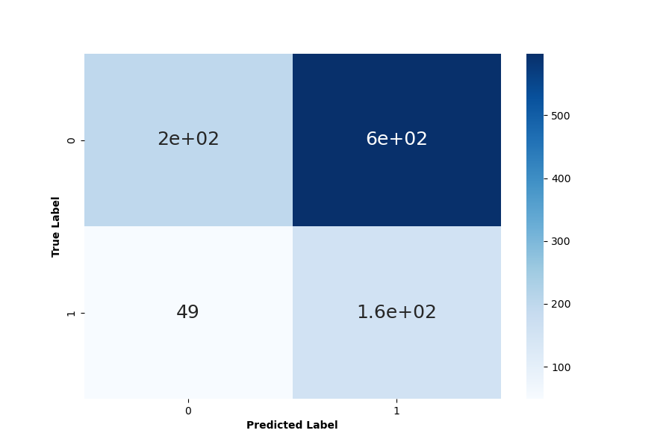
Results
K-Nearest Neighbors Confusion matrix

Slide 12
Discussion and Conclusion
SVM and Logistic Regression achieve the highest accuracy at 80%, but both models have the lowest precision and F1-score among the models built. The Decision Tree has the lowest accuracy and recall but achieves the highest precision at 48% and F1-score. K-Nearest Neighbors (KNN) achieves an accuracy of 79%, with the second-best precision at 46% and F1-score at 45%. KNN also has the highest recall, similar to SVM and Logistic Regression, at 50%.
In conclusion, KNN will be selected for loan prediction.

Slide 13
Q&A

